Slide 1
Cyber Security and Forensics AICT014-4-2-CSF VE3
Threats Analysis

Slide 2
Topic Learning Outcome
At the end of this topic, You should be able to:
Describe Types of Hackers & Threats
Explain Types of Threats
Explain Scanning Method
Describe Vulnerability Analysis
Describe the basis steps that an intruder might undertake in an intrusion
Outline current threats, and their operation

Slide 3
Contents & Structure
Types of Hackers
Threat Actors and their attributes
Types of Threats
Solution – Intruders Prevention
Scanning Method
Vulnerability Analysis

Slide 4
Recap From Last Lesson
Concepts of Security – What is Security
Security objectives / principles - ??
A security concept for a centralized platform that performs three separate identity-based tasks.
Security Management process -??

Slide 5
Type of Hackers / Attackers

Slide 6
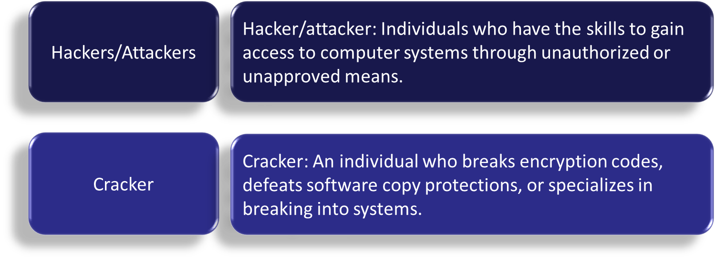
What are Hackers/Attackers/Crackers?

Slide 7

Types of Attackers/Intruders
What are they do?

Slide 8



Type of Hackers/Attackers
White Hat
A hacker who discovers and exposes security flaws in applications and operating systems with an organization’s consent so that they can be fixed before they become widespread problems.
Black Hat
A hacker who discovers and exposes security vulnerabilities without organizational consent, for financial gain, or for some malicious purpose
Grey Hat
A hacker who exposes security flaws in applications and operating systems without consent, but not ostensibly for malicious purposes.

Slide 9
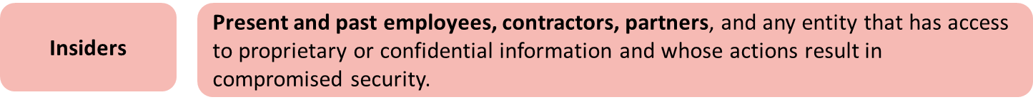
Threat Actors

Slide 10
Threat Actor Attributes
Type of Threat Actor | Attributes
Script kiddie | Internal or external? External. Level of sophistication: Simple code samples and automated attack tools. Resources/Funding: Minimal. Intent/Motivation: Gain attention or prove technical abilities.
Insiders | Internal or external? Internal. Level of sophistication: Varies. Resources/Funding: Varies. Intent/Motivation: Revenge, monetary gain, or even unintentional.
Competitors | Internal or external? External. Level of sophistication: Relatively high. Resources/Funding: Relatively high. Intent/Motivation: Monetary.

Slide 11
Threat Actor Attributes
Type of Threat Actor | Attributes
Organized crime | Internal or external? External. Level of sophistication: Highly sophisticated. Resources/Funding: Amply funded. Intent/Motivation: Monetary profit, through ransomware and data theft.
Hacktivist | Internal or external? External. Level of sophistication: Varies. Resources/Funding: Varies. Intent/Motivation: Cause social or political change.
Nation states | Internal or external? External. Level of sophistication: Highly sophisticated. Resources/Funding: Amply funded. Intent/Motivation: Political, military, technical, or economic agendas.

Slide 12
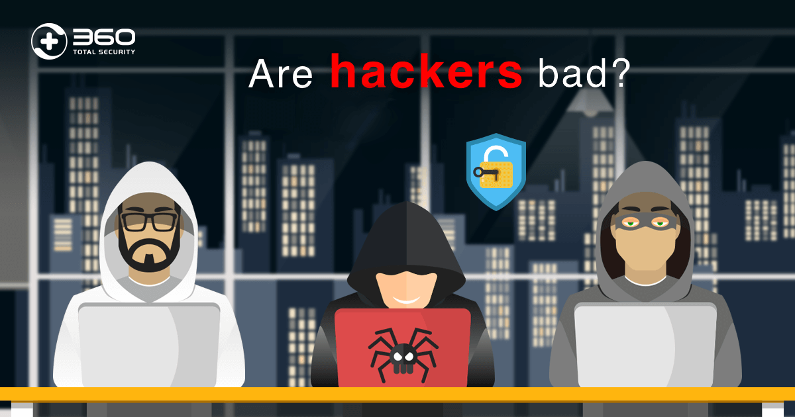
Quick Review Question
What makes them different from each other?

Slide 13
Types of Threats

Slide 14
Types of Threats
Intruders
Physical Thefts
Social Engineering
Insider Attacks
Scripts
Bypass Authentication
Botnets
Phishing
Password Cracking

Slide 15
Intruders
An intruder can be a malicious hacker, former employee or one of the thousands of third-party connections organizations have opened to help further business goals.
Masquerader: An individual who is not authorized to use the computer and who penetrates a system’s access controls to exploit a legitimate user’s account
Examples:
Performing a remote root compromise of an e-mail server.
Defacing a Web server.
Guessing and cracking passwords.
Copying a database containing credit card numbers.
Viewing sensitive data, including payroll records and medical information, without authorization.
Running a packet sniffer on a workstation to capture usernames and passwords.
Dialing into an unsecured modem and gaining internal network access.
Posing as an executive, calling the help desk, resetting the executive’s e-mail password, and learning the new password.
Using an unattended, logged-in workstation without permission.
Misfeasor: A legitimate user who accesses data, programs, or resources for which such access is not authorized, or who is authorized for such access but
misuses his or her privileges
Clandestine user: An individual who seizes supervisory control of the system and uses this control to evade auditing and access controls or to suppress audit collection

Slide 16
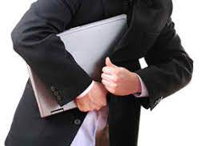
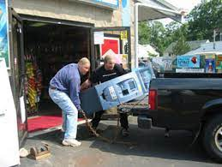
Physical Thefts
Physical thefts cause damage to computer systems hardware and infrastructure. An adversary gains physical access to a system or device through the theft of the item. Possession of a system or device enables a number of unique attacks to be executed and often provides the adversary with an extended timeframe for which to perform an attack. Most protections put in place to secure sensitive information can be defeated when an adversary has physical access and enough time.
Examples: A data center is located in a country known to support domestic companies via industrial espionage. The host country has access to internal data center areas via the use of IT technicians hired by the data center. That “insider” could copy the VM to portable storage media and then access this data on their own machine without physically stealing a hard drive.
Once an individual has direct access to the virtual disk, he or she has all the time in the world to defeat security mechanisms. These include the use of standard tools such as password cracking and other offline attacks. Importantly, the attacker is accessing a copy of the VM rather than the original file. Therefore, the VM itself will not show any record of intrusion.

Slide 17

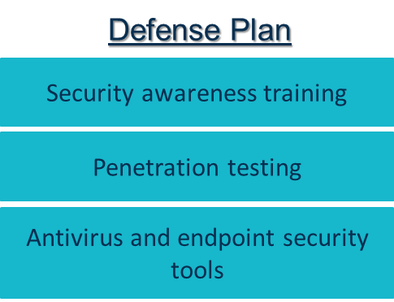
Social Engineering
Social Engineering is the art of manipulating people so that, they give up confidential data and bank information as well as giving them control over your computer. They seek passwords or bank information or access your computer to secretly install malicious software.
Examples:
Phishing: tactics include deceptive emails, websites, and text messages to steal information.
Spear Phishing: email is used to carry out targeted attacks against individuals or businesses.
Baiting: an online and physical social engineering attack that promises the victim a reward.
Malware: victims are tricked into believing that malware is installed on their computer and that if they pay, the malware will be removed.
Pretexting: uses a false identity to trick victims into giving up information.
Water-Holing: an advanced social engineering attack that infects both a website and its visitors with malware.

Slide 18
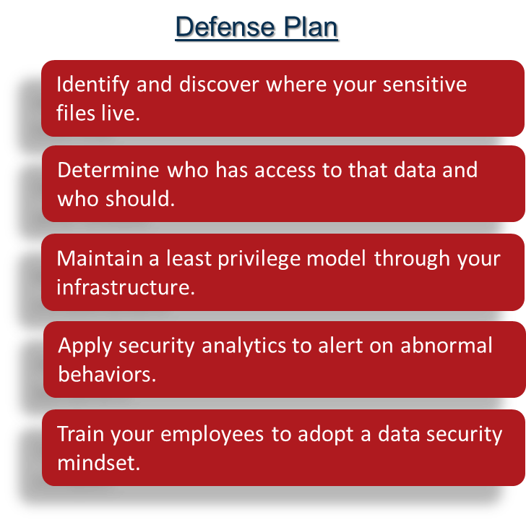
Insider Threats
An insider threat is a malicious threat to an organization that comes from people within the organization, such as employees, former employees, contractors or business associates, who have inside information concerning the organization's security practices, data and computer systems.
Examples (Real incident):
Tesla: A malicious insider sabotaged systems and sent proprietary data to third parties.
Facebook: A security engineer abused his access to stalk women.
Coca-Cola: A malicious insider stole a hard drive full of personnel data.
Suntrust Bank: A malicious insider stole personal data, including account information, for 1.5 million customers to provide to a criminal organization.

Slide 19
Script Threat
Script is written code that is interpreted and implemented by another application. Malware authors have taken advantage of the relative ease of producing scripts and have produced significant numbers of script-based malware, many of which are written using Visual Basic Script, JavaScript, and HTML.
Examples
Wrong credentials are typed, an error message like “Sorry your username or your credentials are wrong” will be displayed.
The username is a parameter that is typed by the user in the login form as <script> function Login(form). This way an attacker can type the malicious script instead of the correct username.
Username
<script> function Login(form)
Password
Password
LOGIN
LOGIN
Defense Plan
Black box testing can be performed.
Code review is always a recommended practice, and it brings more reliable results too.

Slide 20
Bypass Authentication Threat
A flaw in the application that allows users to access application resources without authentication is referred as’ Authentication Bypass’. Authentication bypass vulnerability is generally caused when it is assumed that users will behave in a certain way and failing to foresee the consequences of users doing the unexpected.
Examples:
Imagine a system that uses a parameter “auth” to signify if a user has been authenticated, and prompts for the ‘log in’ procedure if auth=0. As long as auth=1, the user remains authenticated and able to access restricted pages.
While trying to get to a restricted page, a user’s browser might submit the below URL: http://www.mycorporatewebapp.com/remotemanagement.asp?auth=0
Bypassing this authentication might then be as simple as changing auth=0 to auth=1.
Defense Plan
Authenticate each application resource.
Manage session cookies appropriately.
Take extra care while validating authentication parameters to prevent SQL injection attacks. Use parametrized SQL queries or DB stored procedures for database calls.

Slide 21
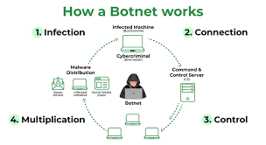
Botnets Threat
Botnet is a number of Internet-connected devices, each of which is running one or more bots. Botnets can be used to perform distributed denial-of-service attack (DDoS attack), steal data, send spam, and allows the attacker to access the device and its connection.
Defense Plan
Improve all user passwords for smart devices.
Avoid buying devices with weak security.
Update admin settings and passwords across all your devices.
Be wary of any email attachments.
Never click links in any message you receive.
Examples:
Prep and Expose - hacker exploits a vulnerability to expose users to malware.
Infect - user devices are infected with malware that can take control of their device.
Activate - hackers mobilize infected devices to carry out attacks.

Slide 22
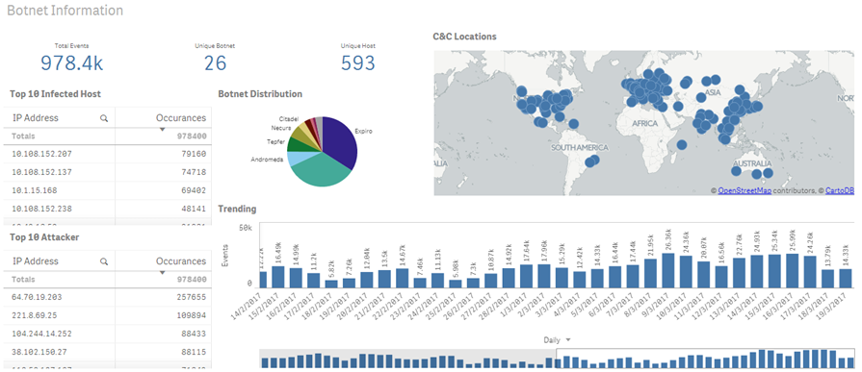
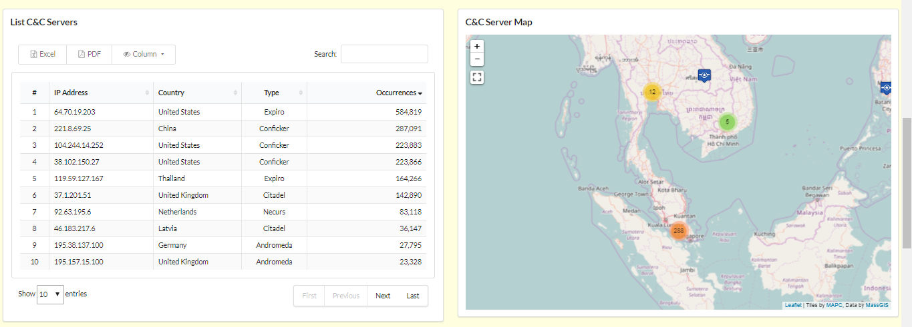
Botnets Threat

Slide 23
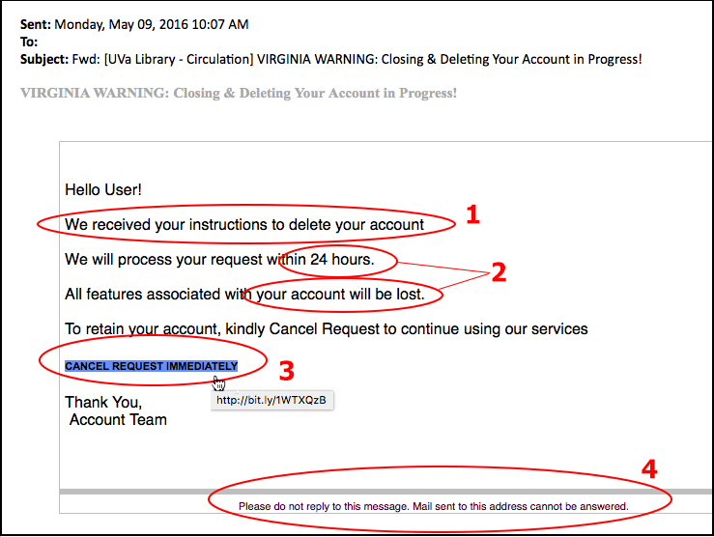
Phishing Threat
Phishing is the attempt to obtain sensitive information such as usernames, passwords, and credit card details (and money), often for malicious reasons, by disguising as a trustworthy entity in an electronic communication.
Examples:
You open your email and suddenly an alert from your bank appears in your inbox.
When you click the link in the email, you are taken to a webpage that looks, more or less, like your bank's — but is actually designed to steal your information.
The alert will say there is a problem with your account and ask you to confirm your login and password.
After entering your credentials on the page that appears, you are usually sent to the actual institution to enter your information a second time.
By steering you to the legitimate institution, you don't immediately realize your information was stolen.
Defense Plan
to install and use proper Internet security software on your computer.
To install Anti-spam software to protect your email account from phishing and junk emails.
To Anti-malware to prevent other types of threats.

Slide 24
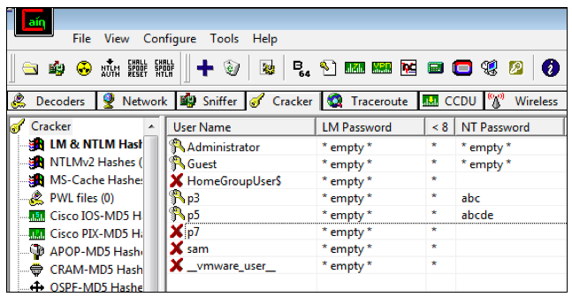
Password Cracking Threat
Password cracking is the process of recovering passwords from data that have been stored in or transmitted by a computer system.
Defense Plan : Strong Password/ Password Structure
Length.
Combine letters, numbers, and special characters.
Do not re-use. Even if your password is strong in theory, re-using it will leave you vulnerable.
Avoid easy-to-guess phrases. A word that’s in the dictionary, etc.
Using MFA
Examples:
Phishing
Malware
Social engineering
Brute force attack
Dictionary attack
Spidering
Guessing
Rainbow table attack

Slide 25
Solutions
White hat hackers (penetration testing)
Code of Ethics
Scanning & Vulnerability analysis
System update/patch

Slide 26
Revision: Security Fundamentals
Password, Firewall, Encryption
Guards Fences
Confidentiality
- Only authorized personnel can access sensitive data
Access control
File Protection
Checksum
Back up servers
Response systems
Integrity
- Only authorized personnel can change sensitive data
Availability
- Only authorized personnel can access to data
CIA

Slide 27
Solution: Scanning
Types of Scans:
Network e.g. Zenmap/nmap, Nesuss, OpenVAS and etc.
Port e.g. Zenmap/nmap, Nesuss, OpenVAS
OS e.g. Nexpose Community Edition
Ping Sweep e.g. fping
The ping sweep is a method that can establish a range of IP addresses which map to live hosts.
Application e.g. QualysGuard
Identify potential security vulnerabilities in the web application and architectural weaknesses. e.g. Cross Site Scripting (XSS) attacks are a type of injection, n which malicious scripts are injected into benign and trusted web site.

Slide 28
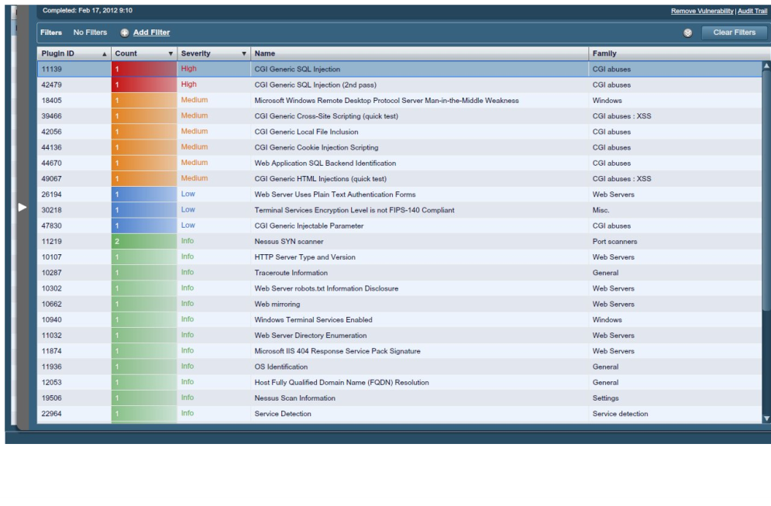
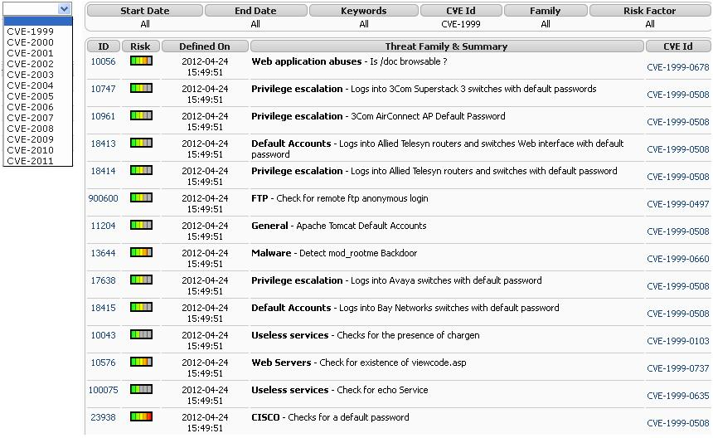
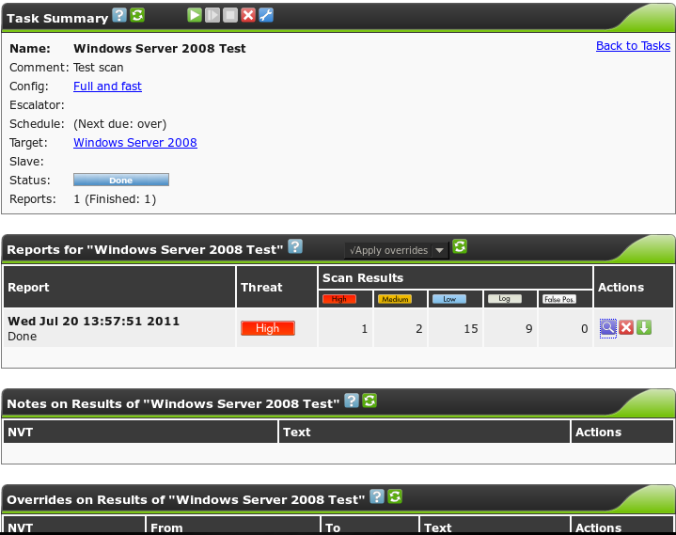
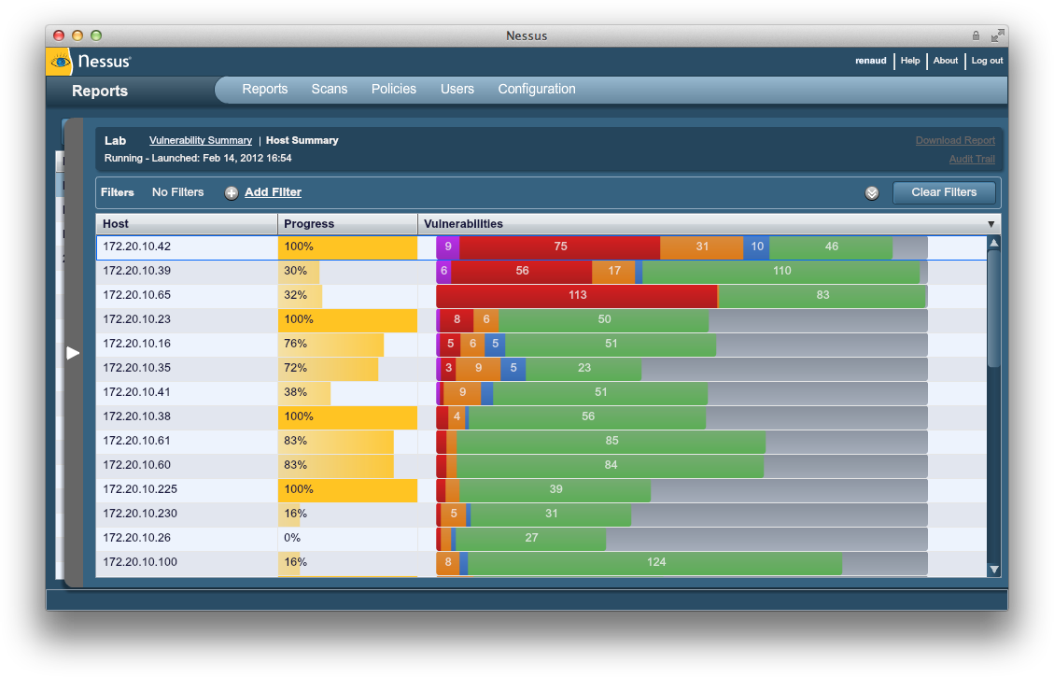
Solution: Vulnerability Analysis
Tools: OpenVAS, Nessus

Slide 29
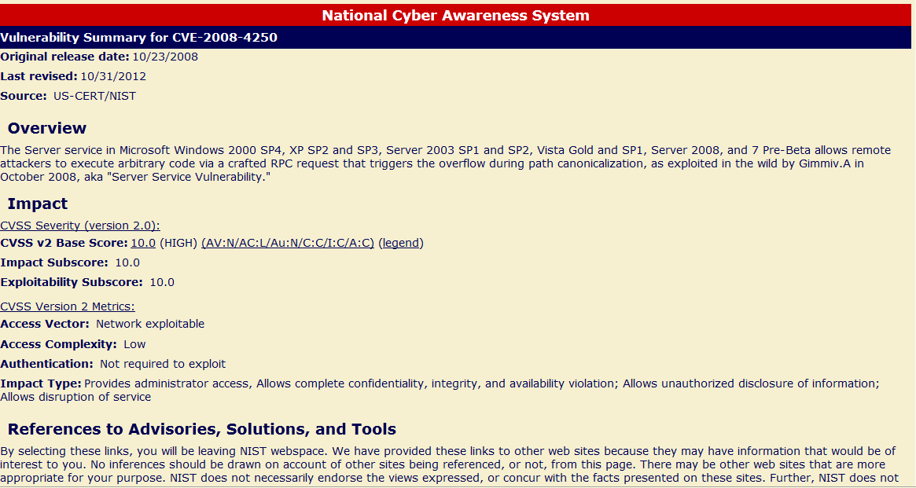
Solution: Vulnerability Analysis
Common Vulnerability & Exposures (CVE)
Sample: CVE-2008-4250

Slide 30
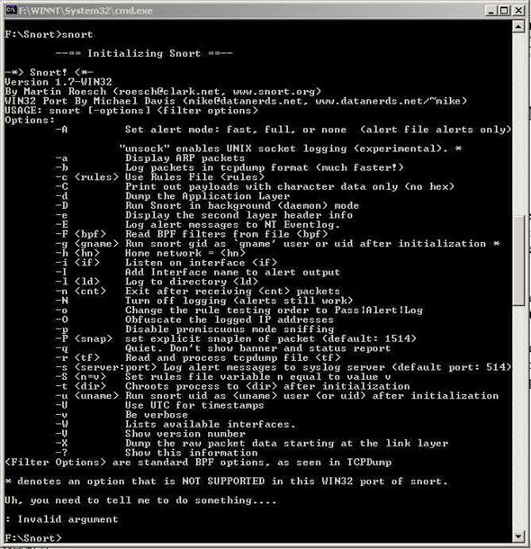
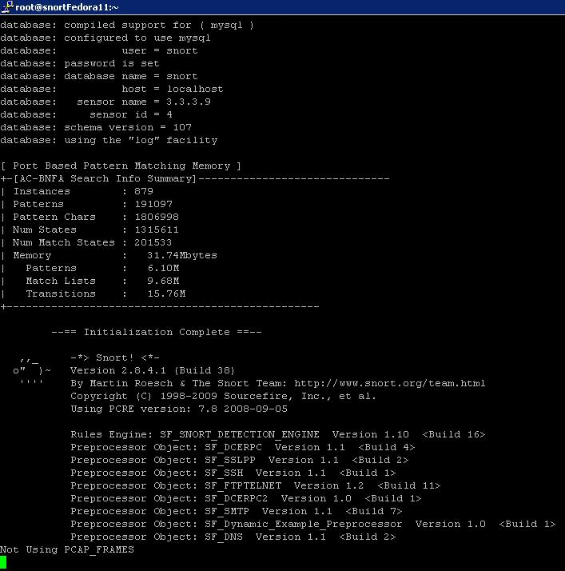
Solution: Intruders Detection System
IDS, IPS, rules E.g. Snort

Slide 31
Summary
Different types of Hackers – black, white &grey
Threat actors and its attributes
Different types of threats and their operation
method to prevent
Intruders use different ways to obtain information
Vulnerability scanning and analysis

Slide 32

QUIZIZZ
https://quizizz.com/join

Slide 33
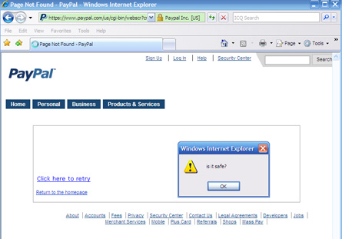
Extra: Common Attacks
Cross Site Scripting (XSS)
Found in Web Application
Attackers inject client-side script

Slide 34
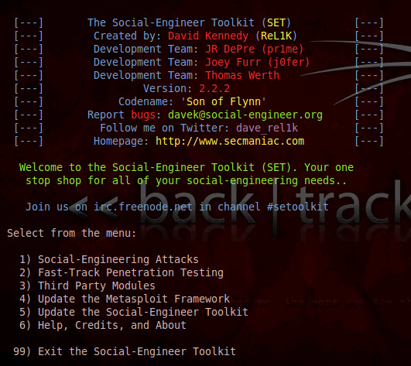
Extra: Common Attacks
Social Engineering
Manipulating people to perform actions of revealing confidential information

Slide 35
What we cover next
PKI and Cryptography

